Slide 1
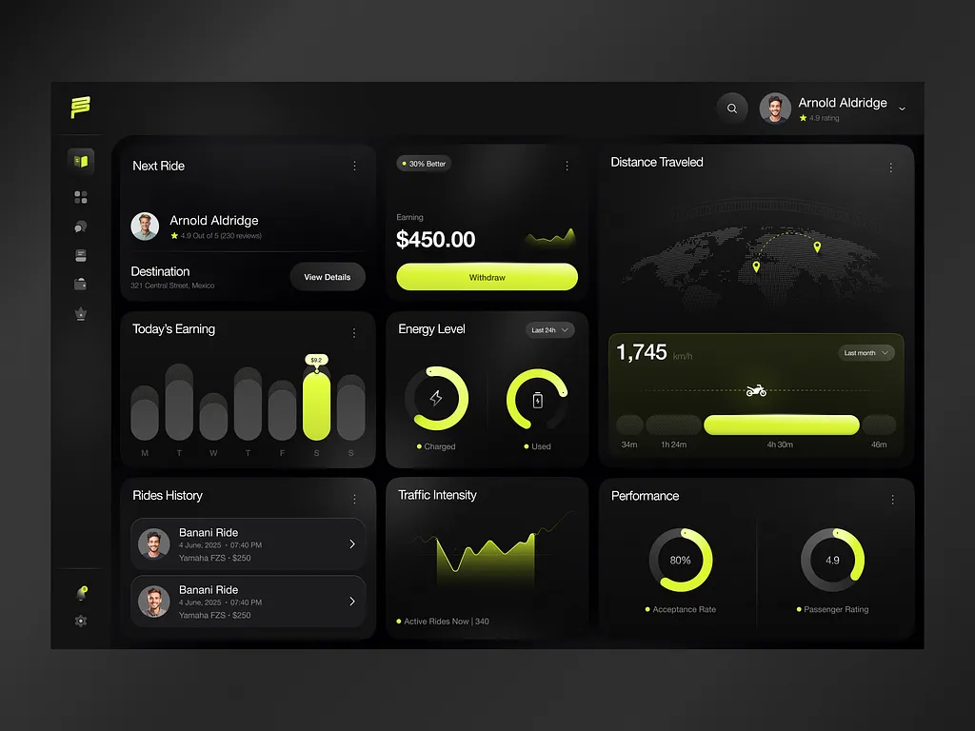

Slide 2
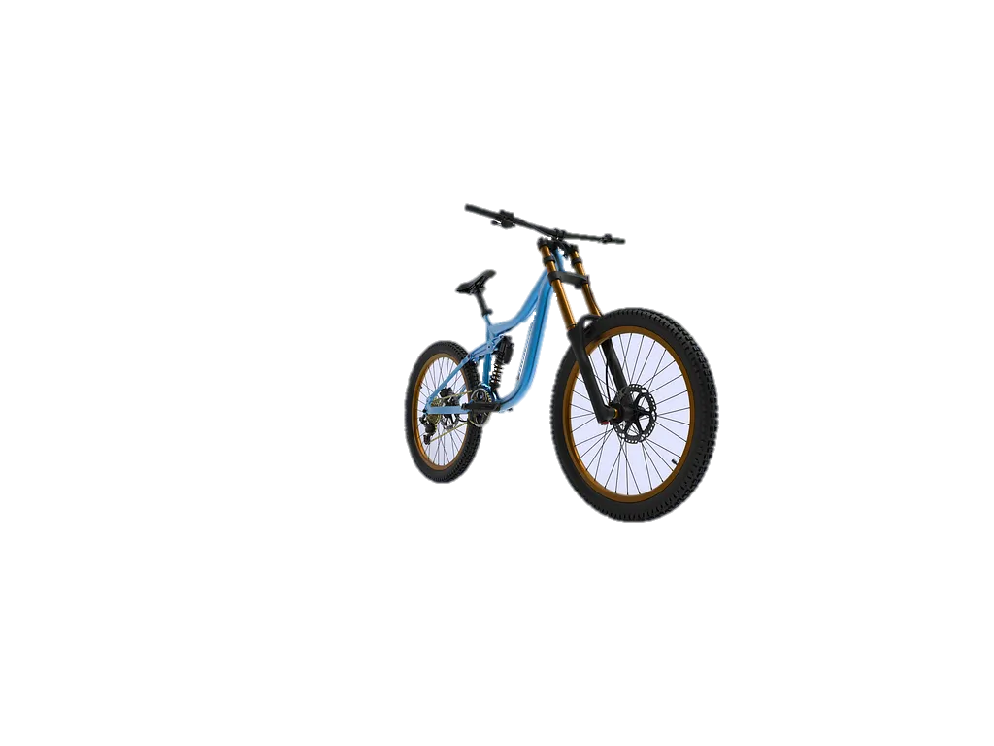
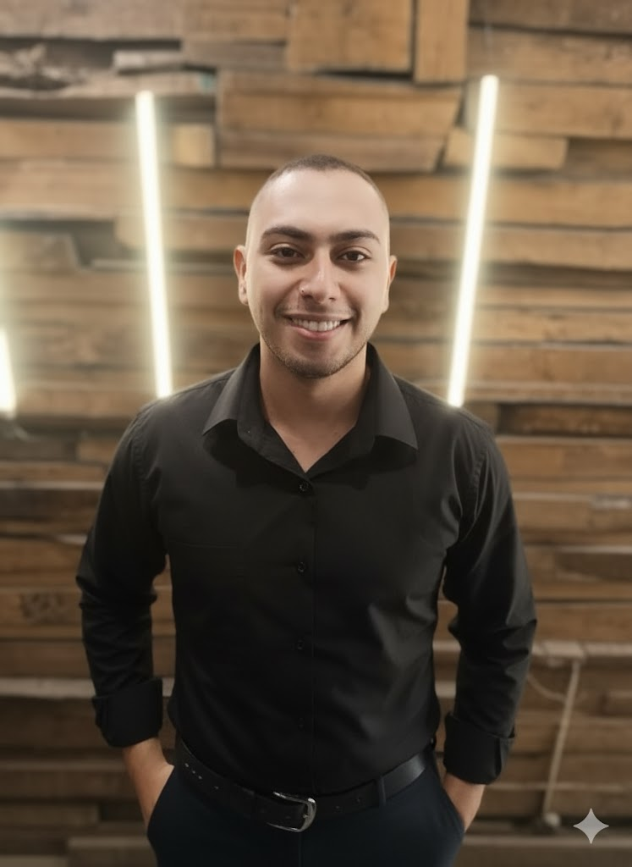





Bikes Store
Business performance overview
Hi, I am Salah
Pages
🙋🏻‍♂️Let’s connect :

